Slide 1

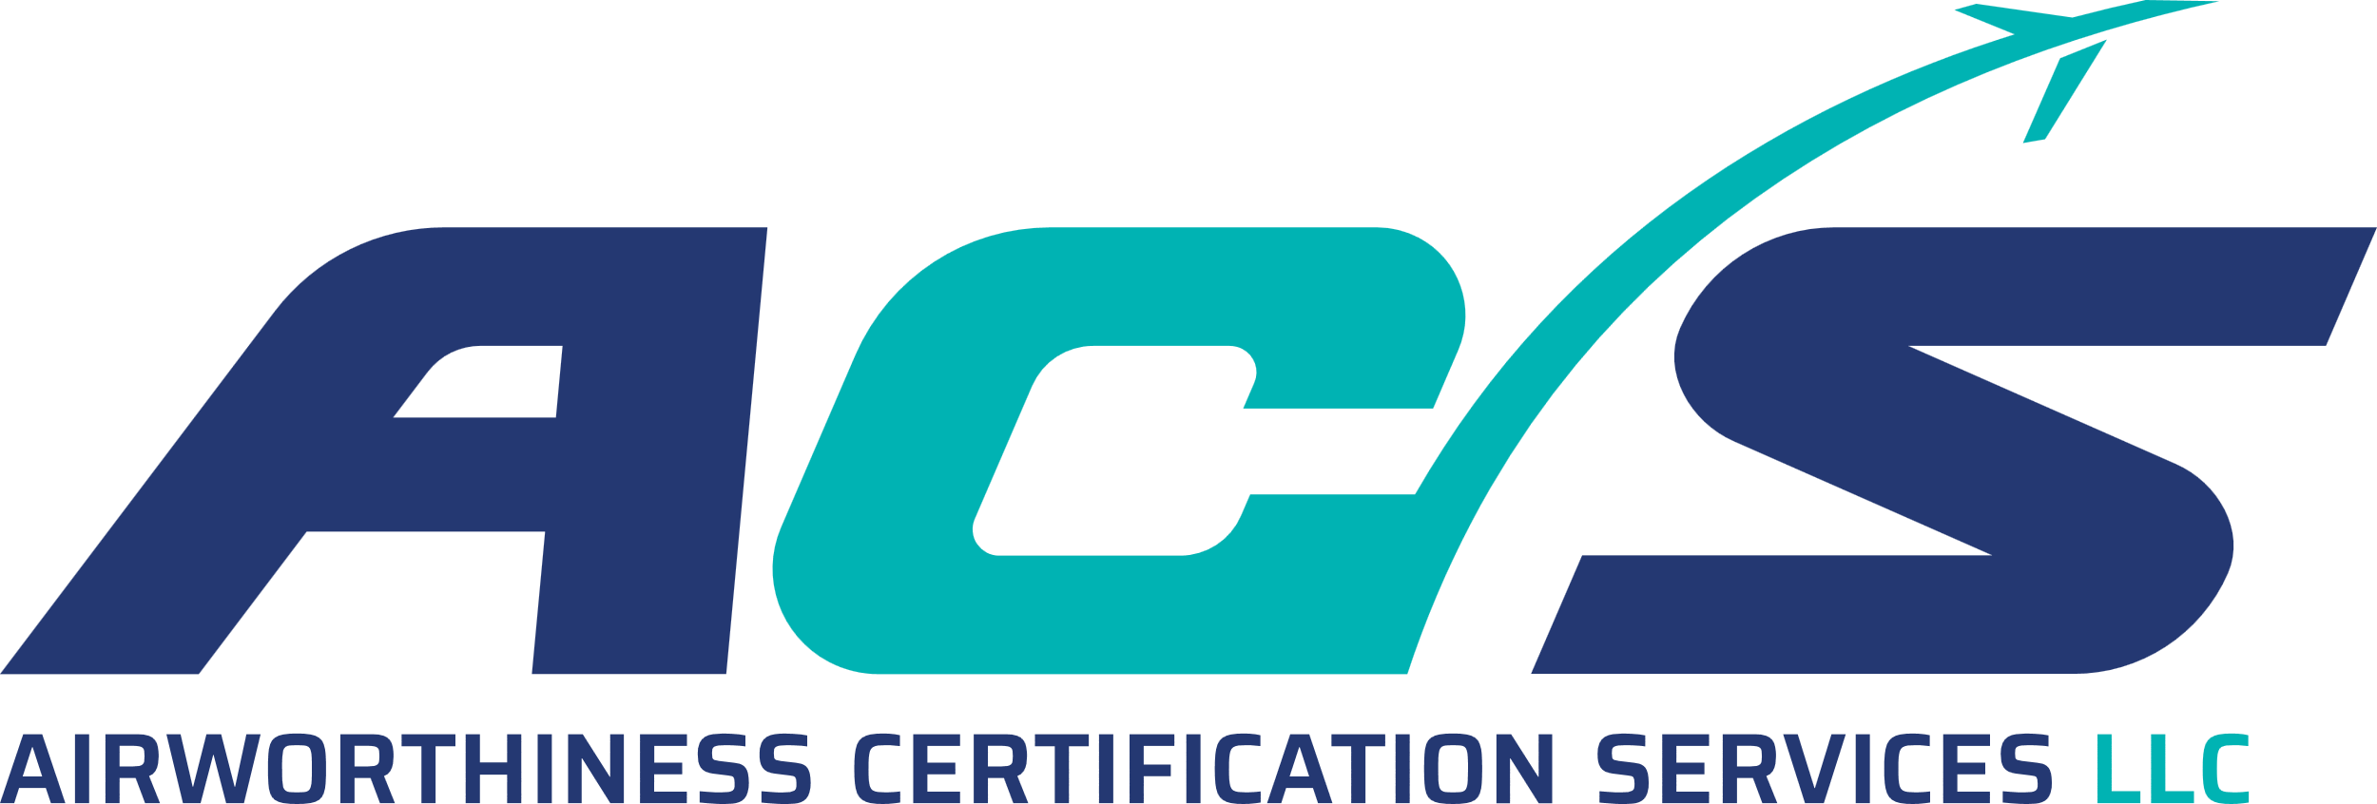
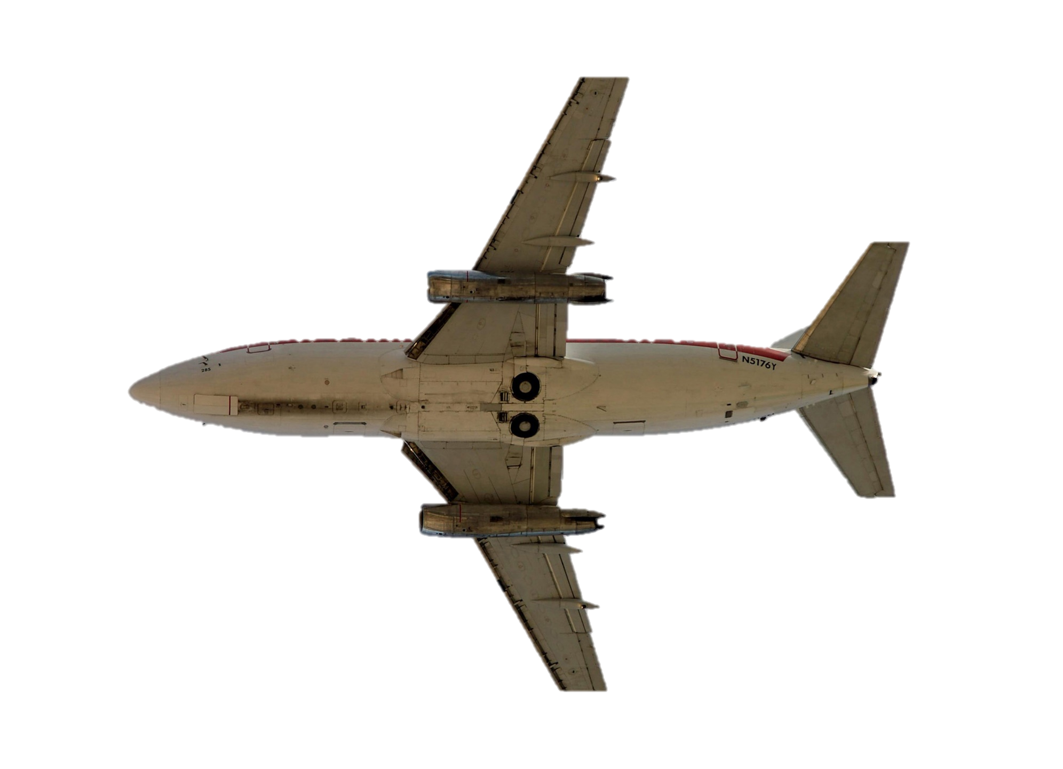
TR-107
CERTIFICATION OVERVIEW: Aircraft and Systems to Hardware/Software
This half-day course is best suited for the hardware/software engineer or manager wanting to understand the greater scope of Aircraft/System level development and certification processes including their interfaces to the item level compliance processes.
Explore the certification environment including the FAA, EASA, and other Regulatory Agencies
Explore the High-Level Regulation and how that drives certification and compliance top down
Understand what is a Means of Compliance and how this relates to industry standards
Examine the policy and processes for aircraft and systems certification
Understand safety assessment in the context of system development
See the connections from aircraft to item level policy
Since 2000, Tammy Reeve, President of Patmos Engineering Services, has been involved in compliance auditing for airborne software and electronic hardware that make up modern aircraft systems. In 2008, the FAA awarded Patmos Engineering Services the contract for developing and delivering the “Complex Electronic Hardware” training course that was taught at the FAA Academy to DO-254 program auditors.
From both her compliance auditing experience and FAA training experience, Tammy developed this course offering for systems developers and DO-178C/DO-254 applicants seeking a big picture understanding of aircraft certification and compliance. The feedback Tammy’s training courses has been overwhelmingly positive.
Patmos offers this and several other industry leading compliance training courses, which can be delivered on-site or on-line, and can be tailored to your specific needs. You can also pair these classes with any other Patmos offering (such as a process “Gap Analysis”) for a fully customized services package.
Knowledge
Integrity Efficiency

Slide 2
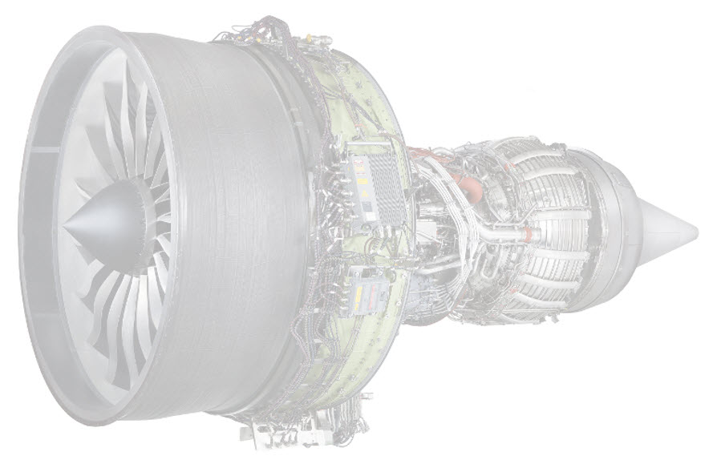
TR-107
Certification Overview Training Outline
Civil Aircraft Certification and the FAA
Certification Authorities
FAA, EASA, etc.
DOAs, ODAs, Designations and Approval
CFR (and EASA Equivalent) Regulations
Regulation and Policy
Civil and Military Regulation
Types of Approval Certificates
Type Certificate
Products and Parts Approval
Technical Standard Orders
Part Manufacturer Approval
Supplemental Type Certificates
Production Certificate
Means of Compliance and Overview of the FAA Regulation
Potential Means of Compliances
Industry Standards as MOC
DO-178C
DO-254
Other SW/HW Certification Related Documents
DO-160G
ARP 4754B
Design Assurance Level, FDALs and IDALs
No Better Choice than Patmos.
Patmos engineering services, Inc.
13021 Point Richmond Beach Rd NW
Gig Harbor, WA 98335 Phone/fax: (425) 427-1956
www.Patmos-Eng.com
Patmos engineering services, Inc.
25327 SE Mirrormont Blvd., Issaquah, WA 98027 Phone/fax: (425) 427-1956
www.Patmos-Eng.com

